Slide 1

18CSC207J – Advanced Programming Practice
C.Arun, Asst. Prof. Dept of Software Engineering, School of Computing, SRMIST

Slide 2

Imperative Programming Paradigm

Slide 3
Topics
Program state, instructions to change the program state
Combining Algorithms and Data Structures
Imperative Vs Declarative Programming
Other Languages: PHP, Ruby, Perl, Swift
Demo: Imperative Programming in Python

Slide 4
INTRODUCTION
In a computer program, a variable stores the data. The contents of these locations at any givenpoint in the
program’s execution are called the program’s state.
Imperative programming is characterized by programming with state and commands which modify the state.
The first imperative programming languages were machinelanguages.

Slide 5
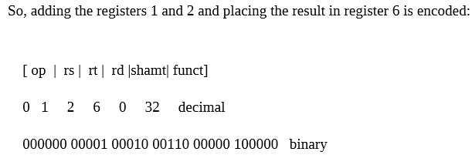
Machine Language
a very specific task, such
load, a jump, or
an ALU operation on a
Each instruction performs as a
unit
For
– rs,
of data in a
CPU register or memory.
example:
rt, and rd
indicate register operands shift amount
– shamt gives a
– the
address or operand
immediate fields contain an
directly

Slide 6
Assembly Code
10110000 01100001
Equivalent Assembly code
B0 61
– B0 - ‘Move a copy of the (AL is a register)
following
valueinto AL’
– 61 is a hexadecimal
representation of the
value01100001 – 97
Intel
MOV
assembly language
AL, 61h; Load AL with 97
decimal
(61 hex)

Slide 7
Other Languages
FORTRAN(FORmula
TRANslation) was
the first
It was
high level designed notation,
language to gain wide
scientific applications and
acceptance.
featured an algebraic
for
types,
subprograms, and
formatted
Business
input/output.
Oriented
COBOL (COmmon at
in for
ALGOL
in
Language) Department
was designed of Defence
need
the initiative of the U. 1959 and implemented in
S.
1960 to
meet the
business data processing
applications.
Language) committee
60 (ALGorithmic Oriented 1960 by an international
was designed
for use in
scientific problem solving

Slide 8
Evolutionary developments
PL / I to FORTRAN
Algol to PL /I
COBOL to PL/I
LISP to PL/I
Block structure
Control statements
Recursion
Subprograms
Formatted IO
File
manipulation
Record
Dynamic storage allocation
Linked structures

Slide 9
OVERVIEW
In imperative programming,
a name may be later reassigned to
assigned to a value and
another value.
The collection
of names
and the associated in the
values and the location of
control state.
program constitute the
The state is a logical
model of
storage locations
whichis an association between memory
and values.
A program
states.
in execution generates a sequence of
The transition from one state to the
next is
determined by assignment commands.
operations and sequencing

Slide 10
Highlights on
Assignment,
goto commands
structured programming
Command
Statement
Procedure
Control-flow
Imperative
language
Assertions
Axiomatic semantics
State
Variables
Instructions
Control structures

Slide 11
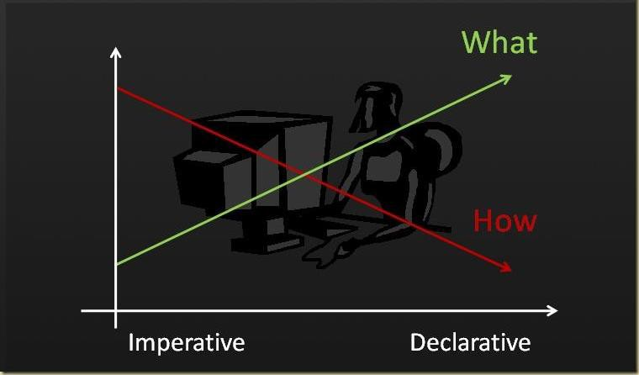
Declarative Vs Imperative

Slide 12


Declarative Vs Imperative
# Declarative
# Imperative

Slide 13
DEMO

Slide 14
An algorithm to add two numbers
entered by user
Step 1: Start
Step 2: Declare variables num1, num2 and sum. Step 3: Read values num1 and num2.
Step 4: Add num1 and num2 and assign the result to
sum. sum←num1+num2
Step 5: Display sum
Step 6: Stop

Slide 15
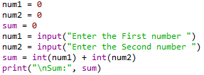

Addition two numbers entered by user

Slide 16
An Algorithm to Get n number, print the same and find Sum of n numbers
Step 1: Start
Step 2: Declare variable sum = 0.
Step 3: Get the value of limit “n”.
Step 4: If limit is reached, goto Step 7 else goto Step 5 Step 5: Get the number from user and add it to sum Step 6: Goto Step 4
Step 7: If limit is reached, goto Step 9 else goto Step 8 Step 8: Print the numbers
Step 9: Goto Step 7
Step 9: Display sum Step 10: Stop

Slide 17
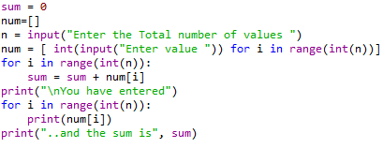
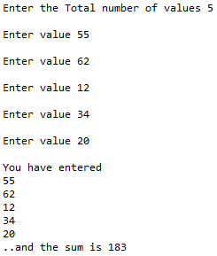

Slide 18



Slide 19
Declarative Vs Imperative

Slide 20
Declarative Vs Imperative
# Declarative
# Imperative

Slide 21
Parallel & Concurrent Programming Paradigm

Slide 22
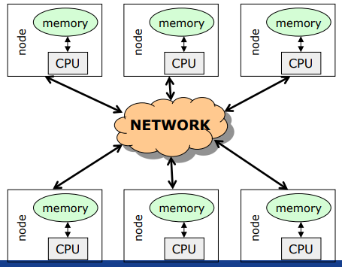
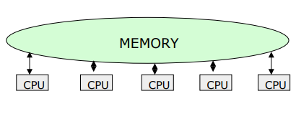
Introduction
A system is said to be parallel if it can support two or more actions executing simultaneously i.e., multiple actions are simultaneously executed in parallel systems.
The evolution of parallel processing, even if slow, gave rise to a considerable variety of programming paradigms.
Parallelism Types:
Explicit Parallelism
Implicit Parallelism
Message Passing Architecture
Shared memory Architecture

Slide 23
Explicit parallelism
Explicit Parallelism is characterized by the presence of explicit constructs in the programming language, aimed at describing (to a certain degree of detail) the way in which the parallel computation will take place.
A wide range of solutions exists within this framework.
One extreme is represented by the ``ancient'' use of basic, low level mechanisms to deal with parallelism--like fork/join primitives, semaphores, etc--eventually added to existing programming languages.
Advantages
allows the highest degree of flexibility (any form of parallel control can be implemented in terms of the basic low level primitives gif)
Disadvantage
Leaves the additional layer of complexity on the shoulders of the programmer, making his task extremely complicated.

Slide 24
Implicit Parallelism
Allows programmers to write their programs without any concern about the exploitation of parallelism.
Parallelism is performed by the compiler and/or the runtime system.
Parallelism is transparent to the programmer maintaining the complexity of software development at the same level of standard sequential programming.
Extracting parallelism implicitly is not an easy task. For imperative programming languages, the complexity of the problem is almost prohibitively and allows positive results only for restricted sets of applications (e.g., applications which perform intensive operations on arrays.
Declarative Programming languages, and in particular Functional and Logic languages, are characterized by a very high level of abstraction, allowing the programmer to focus on what the problem is and leaving implicit details of how the problem should be solved.
Declarative languages have opened new doors to automatic exploitation of parallelism. Their focusing on a high level description of the problem and their mathematical nature turned into positive properties for implicit exploitation of parallelism.

Slide 25
Methods for parallelism
There are many methods of programming parallel computers. Two of the most common are message passing and data parallel.
Message Passing - the user makes calls to libraries to explicitly share information between processors.
Data Parallel - data partitioning determines parallelism
Shared Memory - multiple processes sharing common memory space
Remote Memory Operation - set of processes in which a process can access the memory of another process without its participation
Threads - a single process having multiple (concurrent) execution paths
Combined Models - composed of two or more of the above.

Slide 26
Methods for parallelism
Message Passing:
Each Processor has direct access only to its local memory
Processors are connected via high-speed interconnect
Data exchange is done via explicit processor-to-processor communication i.e processes communicate by sending and receiving messages : send/receive messages
Data transfer requires cooperative operations to be performed by each process (a send operation must have matching receive)
Data Parallel:
Each process works on a different part of the same data structure
Processors have direct access to global memory and I/O through bus or fast switching network
Each processor also has its own memory (cache)
Data structures are shared in global address space
Concurrent access to shared memory must be coordinated
All message passing is done invisibly to the programmer

Slide 27
Steps in Parallelism
Identify parallelism, by recognizing the components of the program execution that will be (potentially) performed by different processors;
Start and stop parallel executions;
Coordinate the parallel executions (e.g., specify and implement interactions between concurrent components).

Slide 28
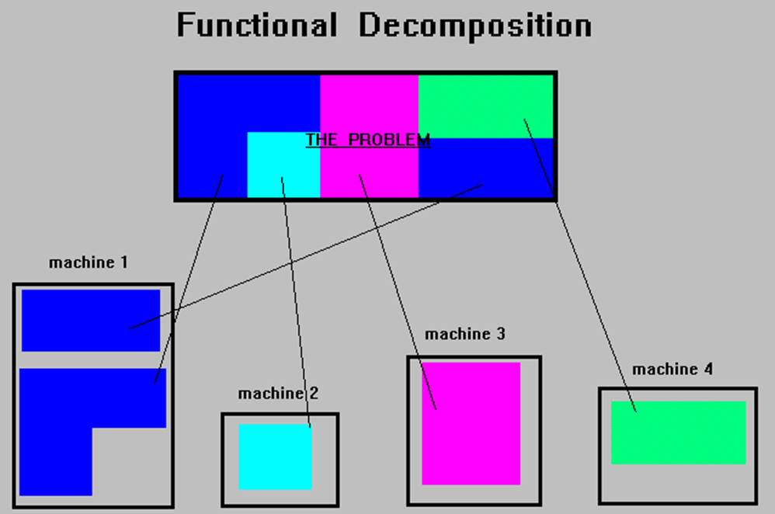
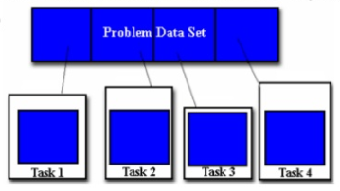
Ways for Parallelism
Functional Decomposition (Functional Parallelism)
Decomposing the problem into different tasks which can be distributed to multiple processors for simultaneous execution
Good to use when there is non static structure or fixed determination of number of calculations to be performed
Domain Decomposition (Data Parallelism)
Partitioning the problem's data domain and distributing portions to multiple processors for simultaneous execution
Good to use for problems where:
data is static (factoring and solving large matrix or finite difference calculations)
dynamic data structure tied to single entity where entity can be subsetted (large multi-body problems)
domain is fixed but computation within various regions of the domain is dynamic (fluid vortices models)

Slide 29
Parallel Programming Paradigm
Phase parallel
Divide and conquer
Pipeline
Process farm
Work pool
Note:
The parallel program consists of number of super steps, and each super step has two phases : computation phase and interaction phase

Slide 30
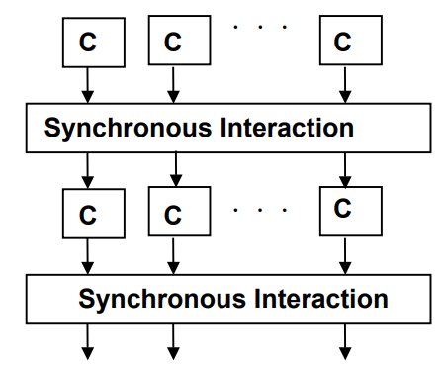
Phase Parallel Model
The phase-parallel model offers a paradigm that is widely used in parallel programming.
The parallel program consists of a number of supersteps, and each has two phases.
In a computation phase, multiple processes each perform an independent computation C.
In the subsequent interaction phase, the processes perform one or more synchronous interaction operations, such as a barrier or a blocking communication.
Then next superstep is executed.

Slide 31
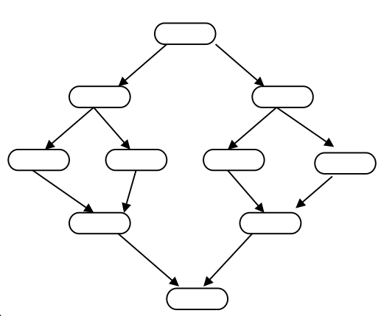
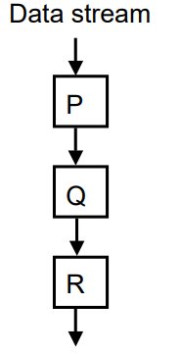
Divide and Conquer & Pipeline model
A parent process divides its workload into several smaller pieces and assigns them to a number of child processes.
The child processes then compute their workload in parallel and the results are merged by the parent.
The dividing and the merging procedures are done recursively.
This paradigm is very natural for computations such as quick sort.
Pipeline
In pipeline paradigm, a number of processes form a virtual pipeline.
A continuous data stream is fed into the pipeline, and the processes execute at different pipeline stages simultaneously in an overlapped fashion.

Slide 32
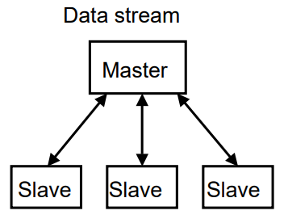
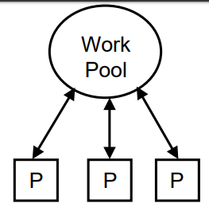
Process Farm & Work Pool Model
This paradigm is also known as the master-slave paradigm.
A master process executes the essentially sequential part of the parallel program and spawns a number of slave processes to execute the parallel workload.
When a slave finishes its workload, it informs the master which assigns a new workload to the slave.
This is a very simple paradigm, where the coordination is done by the master.
This paradigm is often used in a shared variable model.
A pool of works is realized in a global data structure.
A number of processes are created. Initially, there may be just one piece of work in the pool.
Any free process fetches a piece of work from the pool and executes it, producing zero, one, or more new work pieces put into the pool. The parallel program ends when the work pool becomes empty.
This paradigm facilitates load balancing, as the workload is dynamically allocated to free processes.

Slide 33
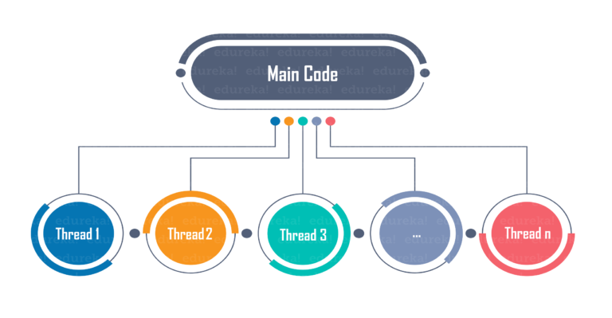
Parallel Program using Python
Multitasking, in general, is the capability of performing multiple tasks simultaneously. Multithreading refers to concurrently executing multiple threads by rapidly switching the control of the CPU between threads (called context switching).
Python Global Interpreter Lock limits one thread to run at a time even if the machine contains multiple processors.
There are two types of multitasking in an OS:
Process-based
Thread-based
Threads in Python can be created in three ways:
Without creating a class
By extending Thread class
Without extending Thread class

Slide 34
Parallel Program using Python
A thread is basically an independent flow of execution. A single process can consist of multiple threads. Each thread in a program performs a particular task. For Example, when you are playing a game say FIFA on your PC, the game as a whole is a single process, but it consists of several threads responsible for playing the music, taking input from the user, running the opponent synchronously, etc.
Threading is that it allows a user to run different parts of the program in a concurrent manner and make the design of the program simpler.
Multithreading in Python can be achieved by importing the threading module.
Example:
import threading
from threading import *

Slide 35
Parallel Program using Python
Model 1
Without creating a class
step1 : Import modules
step2 : Define the role of thread
step3 : Instantiate the thread by specifying target
step4 : Start the Thread.
from threading import *
def fun():
…….
child = Thread(target = fun)
child.start()
Model 2:
By Extending thread class
step1 : import Modules
Step2 : Extending (inherit) a class from Thread
step3 : Override Run method
step4 : Instantitate the obj for extended class
step5 : call the start method
import threading
class test(Thread):
def run(self):
print("User threads")
ob=test()
ob.start()
Model 3
Without Extending thread class:
step1 : create class
step2 : define method
step3 : Create object for the class
step4 : Instantiate the Thread by passing target method
step5 : class Start method
from threading import *
class Test:
def func(self):
print("Child Thread")
ob=Test()
child = Thread(target= ob.func)
child.start()

Slide 36
Parallel program using Threads in Python
# simplest way to use a Thread is to instantiate it with a target function and call start() to let it begin working.
from threading import Thread,current_thread
print(current_thread().getName())
def mt():
print("Child Thread")
for i in range(11,20):
print(i*2)
def disp():
for i in range(10):
print(i*2)
child=Thread(target=mt)
child.start()
disp()
print("Executing thread name :",current_thread().getName())
from threading import Thread,current_thread
class mythread(Thread):
def run(self):
for x in range(7):
print("Hi from child")
a = mythread()
a.start()
a.join()
print("Bye from",current_thread().getName())

Slide 37
Parallel program using Process in Python
import multiprocessing
def worker(num):
print('Worker:', num)
for i in range(num):
print(i)
return
jobs = []
for i in range(1,5):
p = multiprocessing.Process(target=worker, args=(i+10,))
jobs.append(p)
p.start()

Slide 38
Concurrent Programming Paradigm
Computing systems model the world, and the world contains actors that execute independently of, but communicate with, each other. In modelling the world, many (possibly) parallel executions have to be composed and coordinated, and that's where the study of concurrency comes in.
There are two common models for concurrent programming: shared memory and message passing.
Shared memory. In the shared memory model of concurrency, concurrent modules interact by reading and writing shared objects in memory.
Message passing. In the message-passing model, concurrent modules interact by sending messages to each other through a communication channel. Modules send off messages, and incoming messages to each module are queued up for handling

Slide 39
Issues Concurrent Programming Paradigm
Concurrent programming is programming with multiple tasks. The major issues of concurrent programming are:
Sharing computational resources between the tasks;
Interaction of the tasks.
Objects shared by multiple tasks have to be safe for concurrent access. Such objects are called protected. Tasks accessing such an object interact with each other indirectly through the object.
An access to the protected object can be:
Lock-free, when the task accessing the object is not blocked for a considerable time;
Blocking, otherwise.
Blocking objects can be used for task synchronization. To the examples of such objects belong:
Events;
Mutexes and semaphores;
Waitable timers;
Queues

Slide 40
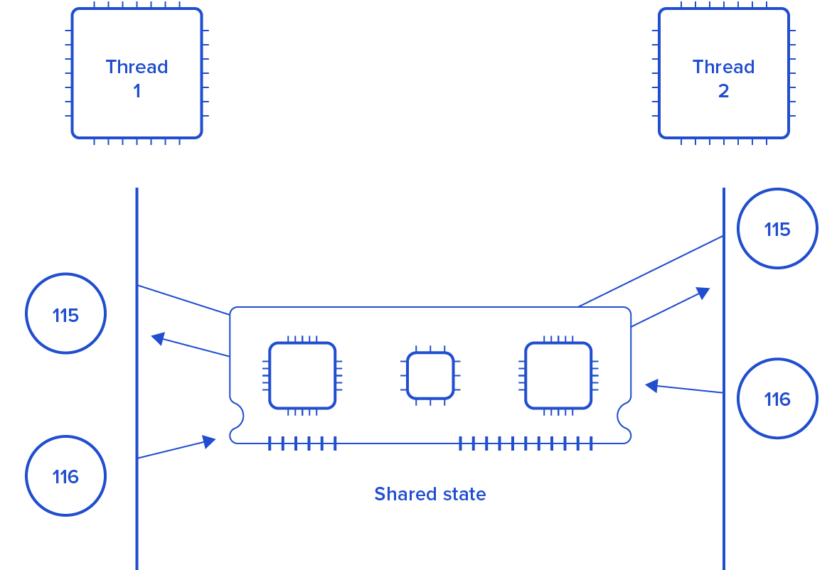
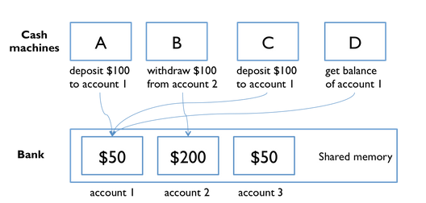
Issues Concurrent Programming Paradigm

Slide 41
Race Condition
import threading
x = 0 # A shared value
COUNT = 100
def incr():
global x
for i in range(COUNT):
x += 1
print(x)
def decr():
global x
for i in range(COUNT):
x -= 1
print(x)
t1 = threading.Thread(target=incr)
t2 = threading.Thread(target=decr)
t1.start()
t2.start()
t1.join()
t2.join()
print(x)

Slide 42
Synchronization in Python
Locks:
Locks are perhaps the simplest synchronization primitives in Python. A Lock has only two states — locked and unlocked (surprise). It is created in the unlocked state and has two principal methods — acquire() and release(). The acquire() method locks the Lock and blocks execution until the release() method in some other co-routine sets it to unlocked.
R-Locks:
R-Lock class is a version of simple locking that only blocks if the lock is held by another thread. While simple locks will block if the same thread attempts to acquire the same lock twice, a re-entrant lock only blocks if another thread currently holds the lock.
Semaphore:
A semaphore has an internal counter rather than a lock flag, and it only blocks if more than a given number of threads have attempted to hold the semaphore. Depending on how the semaphore is initialized, this allows multiple threads to access the same code section simultaneously.

Slide 43
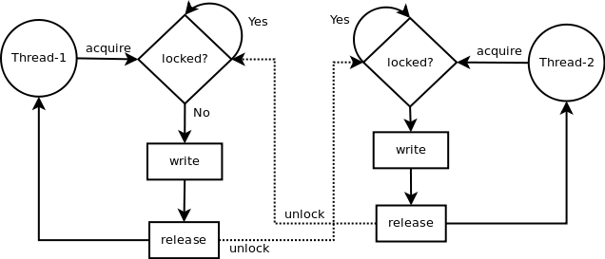
LOCK in python
Synchronization using LOCK
Locks have 2 states: locked and unlocked. 2 methods are used to manipulate them: acquire() and release(). Those are the rules:
if the state is unlocked: a call to acquire() changes the state to locked.
if the state is locked: a call to acquire() blocks until another thread calls release().
if the state is unlocked: a call to release() raises a RuntimeError exception.
if the state is locked: a call to release() changes the state to unlocked().

Slide 44
Synchronization in Python using Lock
import threading
x = 0 # A shared value
COUNT = 100
lock = threading.Lock()
def incr():
global x
lock.acquire()
print("thread locked for increment cur x=",x)
for i in range(COUNT):
x += 1
print(x)
lock.release()
print("thread release from increment cur x=",x)
def decr():
global x
lock.acquire()
print("thread locked for decrement cur x=",x)
for i in range(COUNT):
x -= 1
print(x)
lock.release()
print("thread release from decrement cur x=",x)
t1 = threading.Thread(target=incr)
t2 = threading.Thread(target=decr)
t1.start()
t2.start()
t1.join()
t2.join()

Slide 45
Synchronization in Python using RLock
import threading
class Foo(object):
lock = threading.RLock()
def __init__(self):
self.x = 0
def add(self,n):
with Foo.lock:
self.x += n
def incr(self):
with Foo.lock:
self.add(1)
def decr(self):
with Foo.lock:
self.add(-1)
def adder(f,count):
while count > 0:
f.incr()
count -= 1
def subber(f,count):
while count > 0:
f.decr()
count -= 1
# Create some threads and make sure it works
COUNT = 10
f = Foo()
t1 = threading.Thread(target=adder,args=(f,COUNT))
t2 = threading.Thread(target=subber,args=(f,COUNT))
t1.start()
t2.start()
t1.join()
t2.join()
print(f.x)

Slide 46
Synchronization in Python using Semaphore
import threading
import time
done = threading.Semaphore(0)
item = None
def producer():
global item
print "I'm the producer and I produce data."
print "Producer is going to sleep."
time.sleep(10)
item = "Hello"
print "Producer is alive. Signaling the consumer."
done.release()
def consumer():
print "I'm a consumer and I wait for data."
print "Consumer is waiting."
done.acquire()
print "Consumer got", item
t1 = threading.Thread(target=producer)
t2 = threading.Thread(target=consumer)
t1.start()
t2.start()

Slide 47
Synchronization in Python using event
import threading
import time
item = None
# A semaphore to indicate that an item is available
available = threading.Semaphore(0)
# An event to indicate that processing is complete
completed = threading.Event()
# A worker thread
def worker():
while True:
available.acquire()
print "worker: processing", item
time.sleep(5)
print "worker: done"
completed.set()
# A producer thread
def producer():
global item
for x in range(5):
completed.clear() # Clear the event
item = x # Set the item
print "producer: produced an item"
available.release() # Signal on the semaphore
completed.wait()
print "producer: item was processed"
t1 = threading.Thread(target=producer)
t1.start()
t2 = threading.Thread(target=worker)
t2.setDaemon(True)
t2.start()

Slide 48
Producer and Consumer problem using thread
import threading,time,Queue
items = Queue.Queue()
# A producer thread
def producer():
print "I'm the producer"
for i in range(30):
items.put(i)
time.sleep(1)
# A consumer thread
def consumer():
print "I'm a consumer", threading.currentThread().name
while True:
x = items.get()
print threading.currentThread().name,"got", x
time.sleep(5)
# Launch a bunch of consumers
cons = [threading.Thread(target=consumer)
for i in range(10)]
for c in cons:
c.setDaemon(True)
c.start()
# Run the producer
producer()

Slide 49
Producer and Consumer problem using thread
import threading
import time
# A list of items that are being produced. Note: it is actually
# more efficient to use a collections.deque() object for this.
items = []
# A condition variable for items
items_cv = threading.Condition()
def producer():
print "I'm the producer"
for i in range(30):
with items_cv: # Always must acquire the lock first
items.append(i) # Add an item to the list
items_cv.notify() # Send a notification signal
time.sleep(1)
def consumer():
print "I'm a consumer", threading.currentThread().name
while True:
with items_cv: # Must always acquire the lock
while not items: # Check if there are any items
items_cv.wait() # If not, we have to sleep
x = items.pop(0) # Pop an item off
print threading.currentThread().name,"got", x
time.sleep(5)
cons = [threading.Thread(target=consumer)
for i in range(10)]
for c in cons:
c.setDaemon(True)
c.start()
producer()

